Slide 2
Cristina Pacheco
Arts for L.A.
Talia Gibas
Arts for All
Sibyl O’Malley
California Alliance
for Arts Education

Slide 3
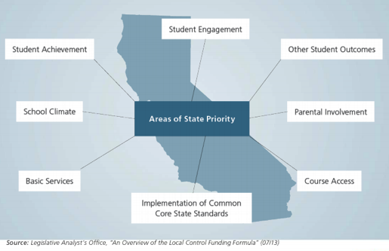
LCFF & Arts Ed

Slide 4
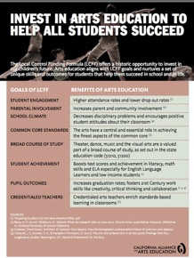
LCFF & Arts Ed

Slide 5
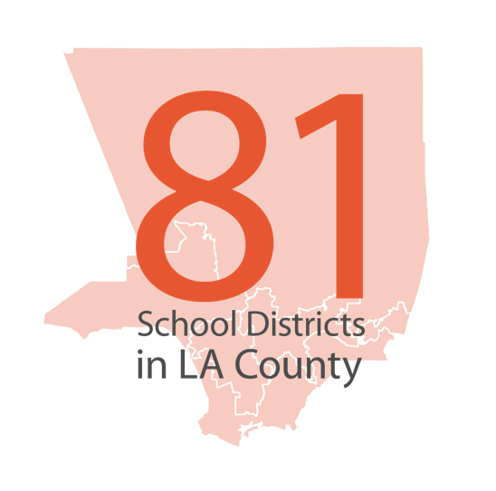
Research initiative analyzing all 81 school district Local Control Accountability Plans
(LCAPs) in LA County.

Slide 6
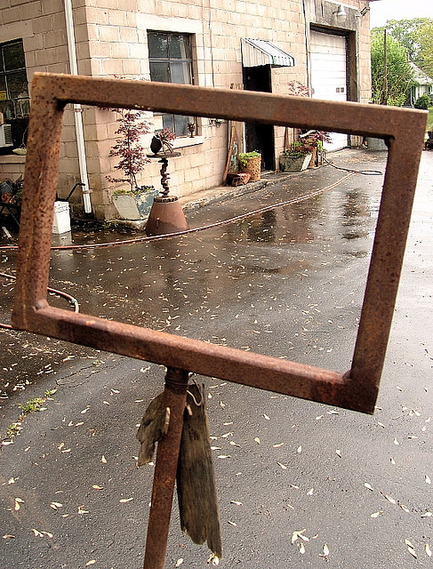
Methodology
Searched for:
Arts/Art
Visual
Performing
Music
VAPA
STEAM
Media
Band
Orchestra
Theater/Theatre
Photo by Zen Sutherland. Creative Commons license.

Slide 7
If We Know Its Incomplete, Why Do We Care?
State funding = greater stability and access (we hope!)
Suggests districts are thinking proactively & tying to arts to
broader district goals
Provides opportunities for accountability and tracking over time

Slide 8
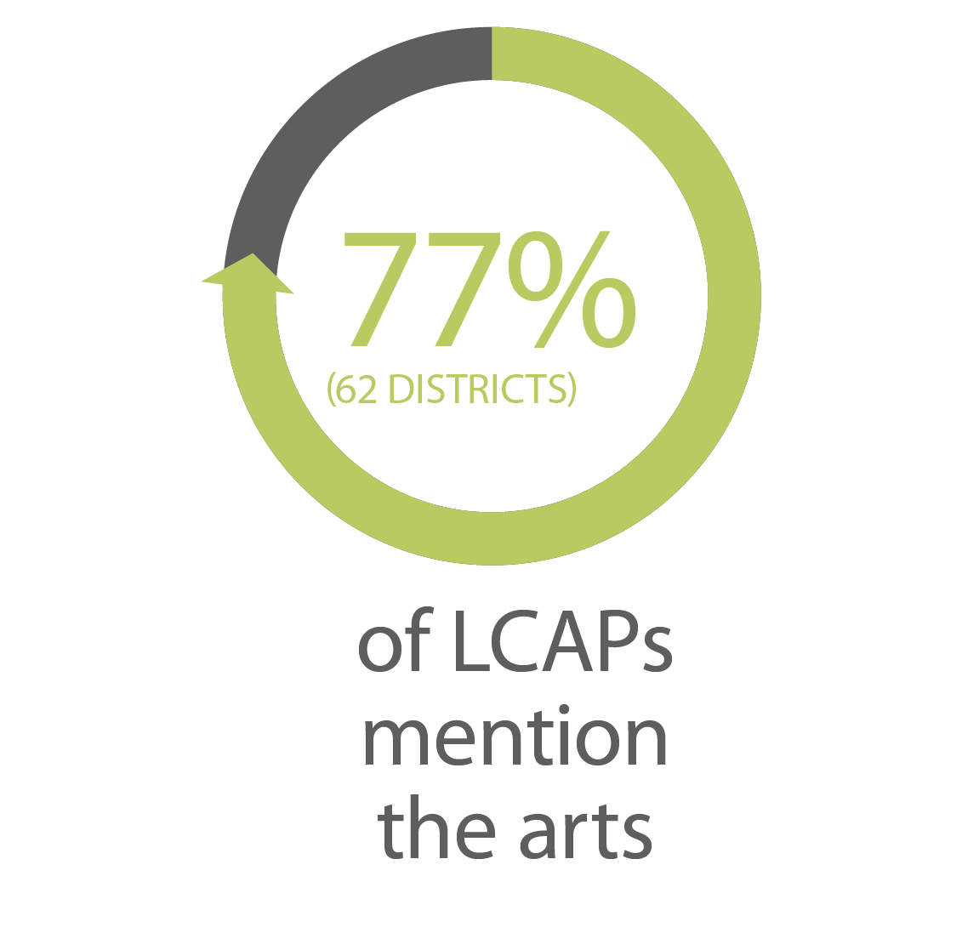
77% mentioned the arts as part of Goals/Progress Indicators or Action/Expenditures

Slide 9
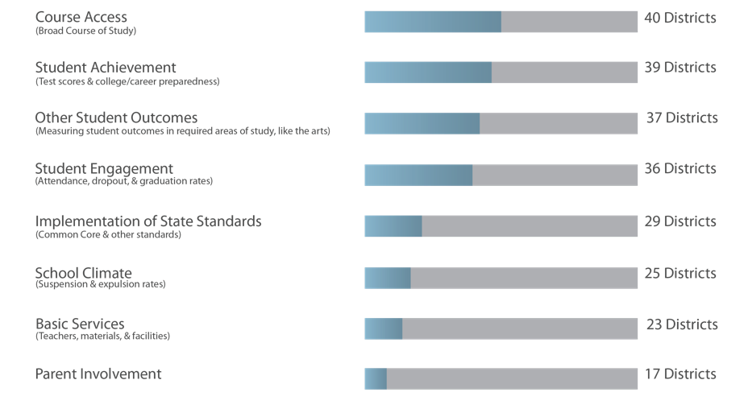

Slide 10
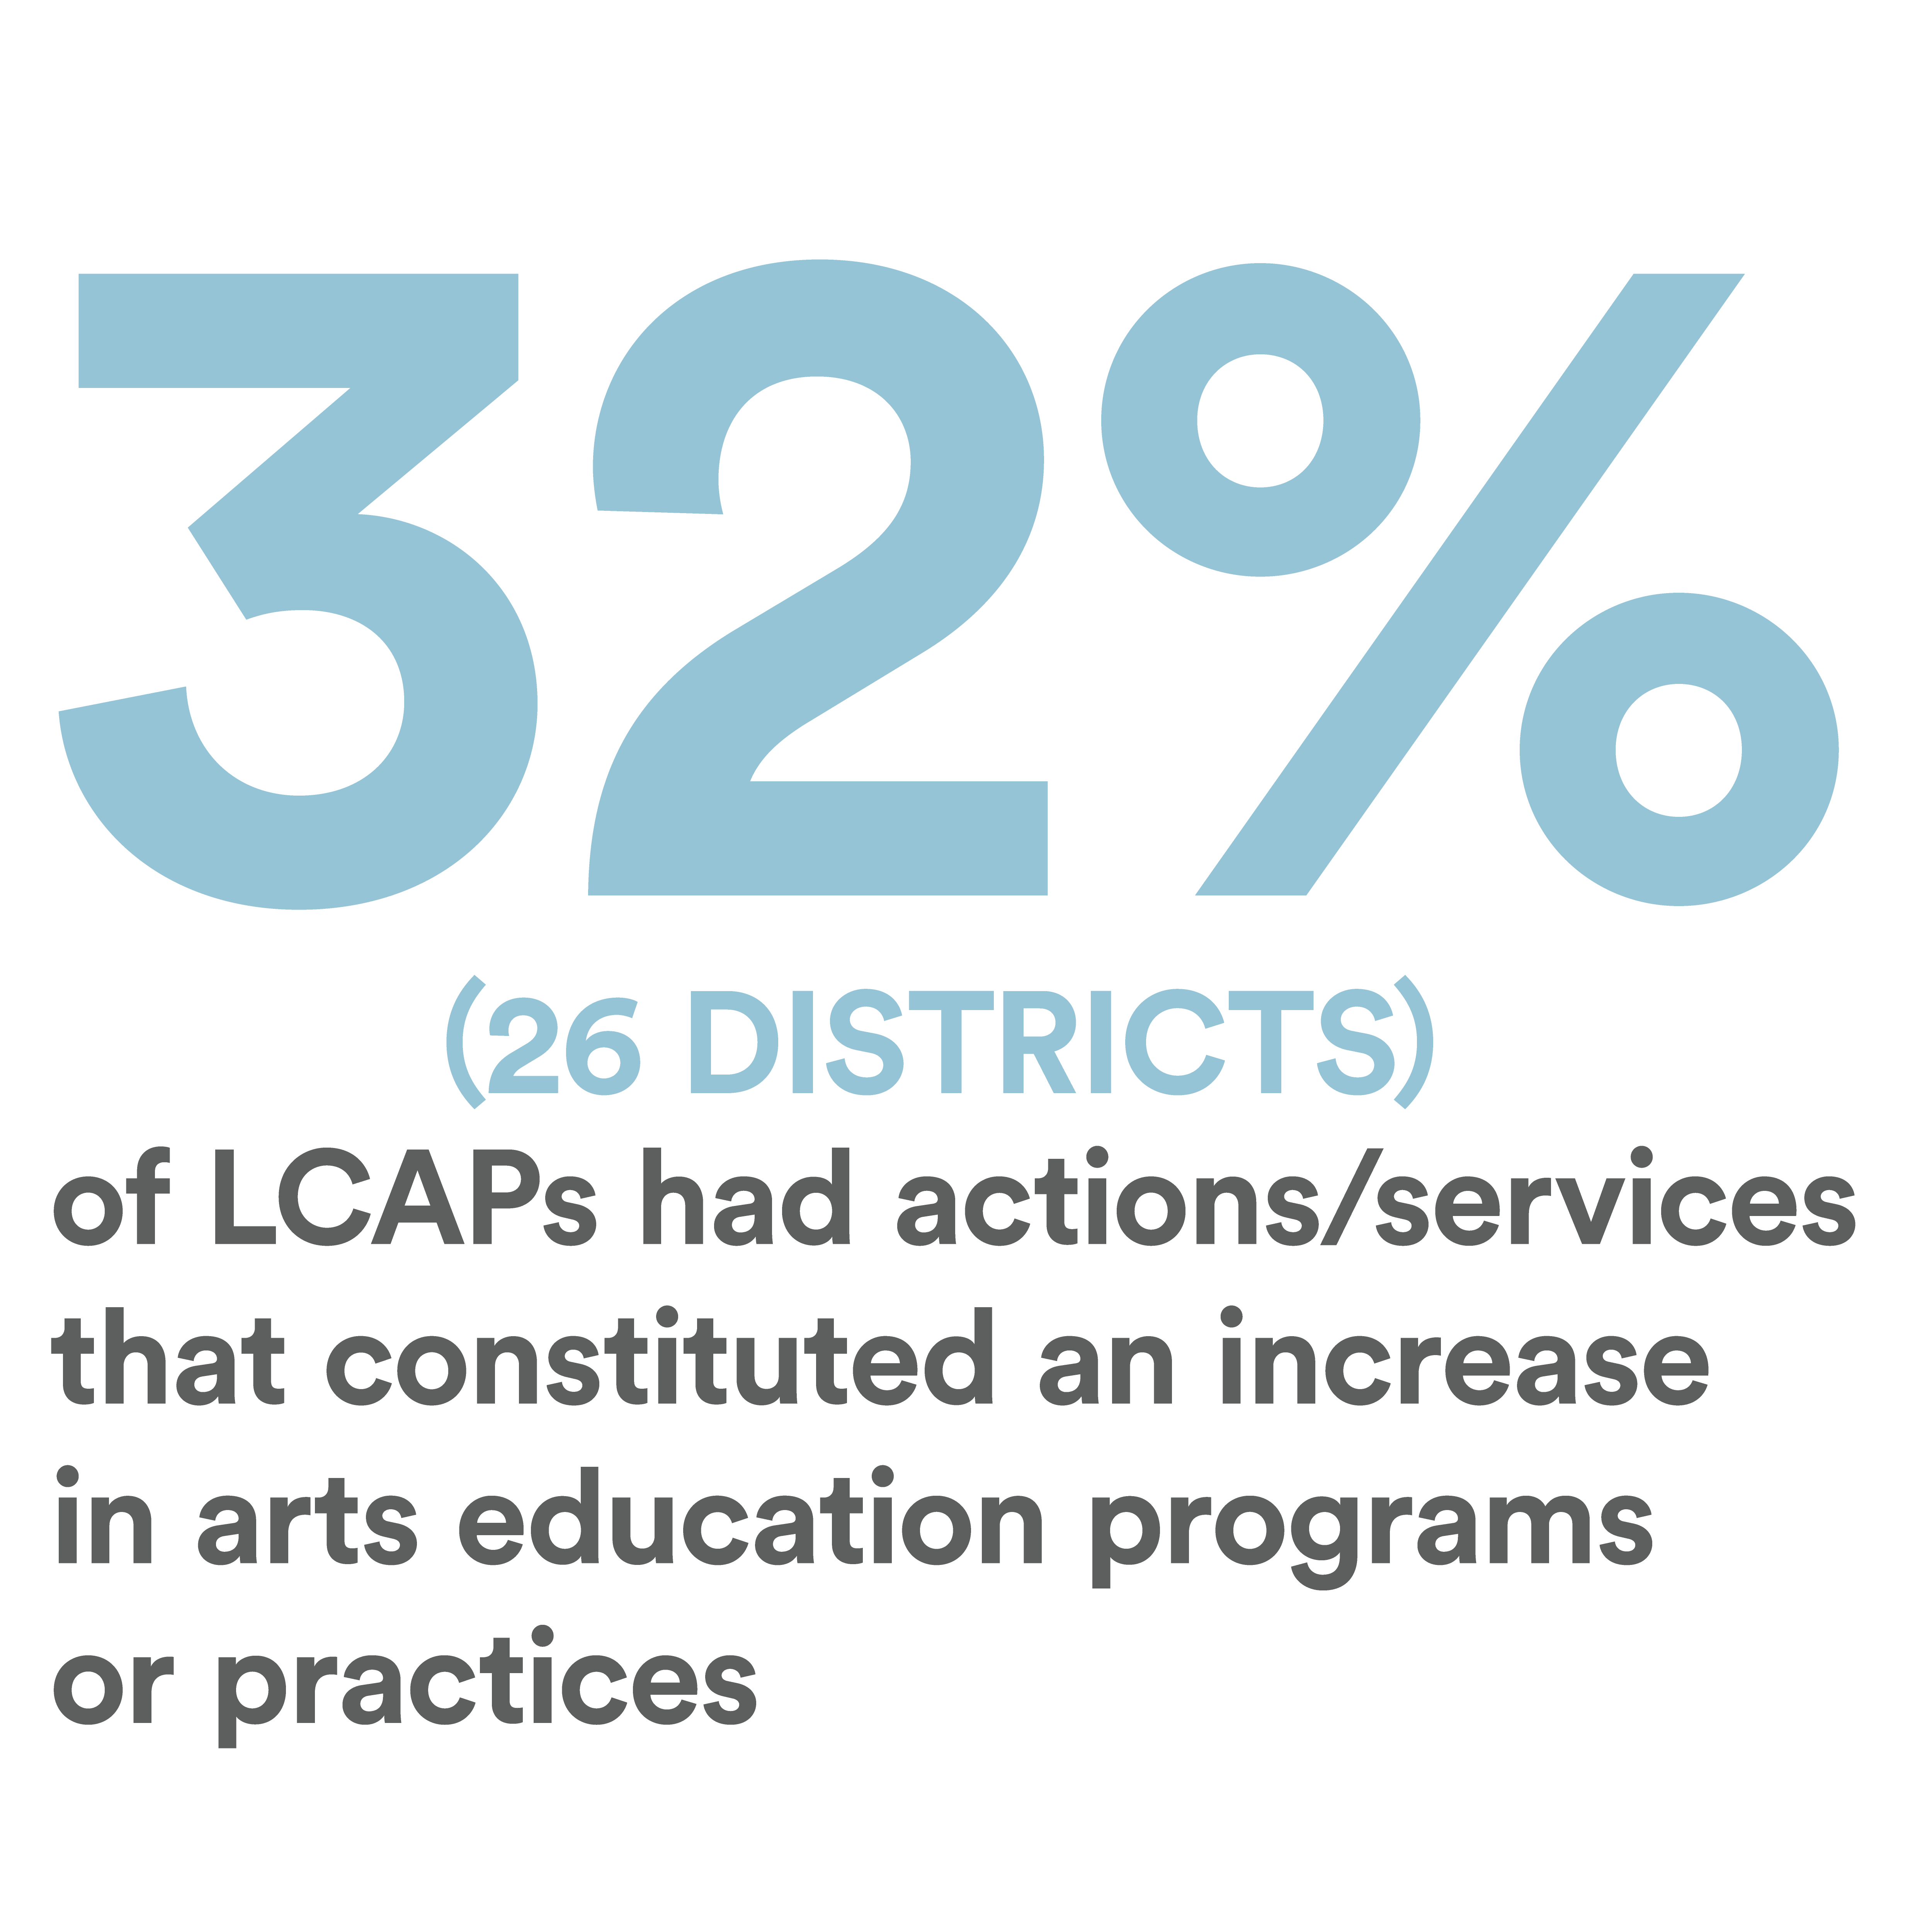

Slide 13
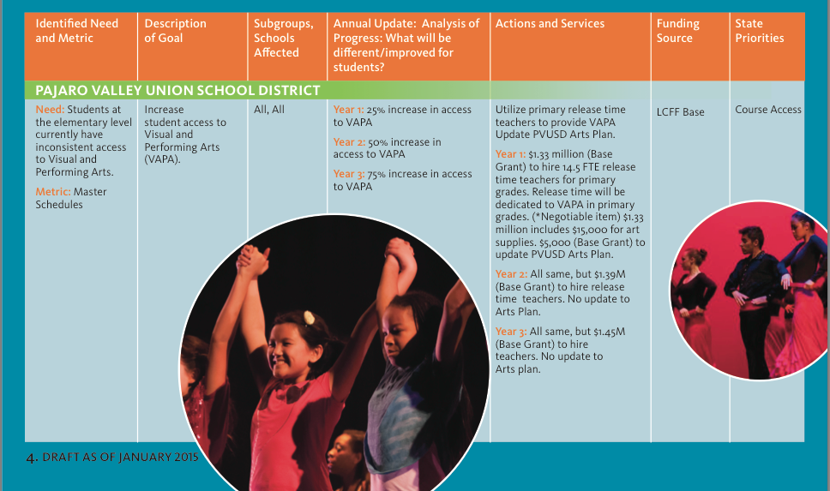

Slide 15
How?

Slide 16
LCAP Timeline

Slide 17
Advocacy Ideas
Arts included in your LCAP | Arts NOT included in your LCAP
Familiarize yourself with the metrics benchmarks for arts actions/services – is your district meeting yearly goals? | Ask about the Annual Update – how can the arts be a strategy for accomplishing district goals?
Monitor the Annual Update – what is the progress on accomplishing goals related to arts strategies? | Work with principals to include the arts in school-site plans

Slide 18
Questions
For more information, visit:
California Alliance for Arts Education:
www.artsed411.org/lcff
Arts for LA:
www.artsforla.org/LCAP-Report-2015 | www.artsforla.org
Arts for All:
www.lacountyartsforall.org/

