Slide 1
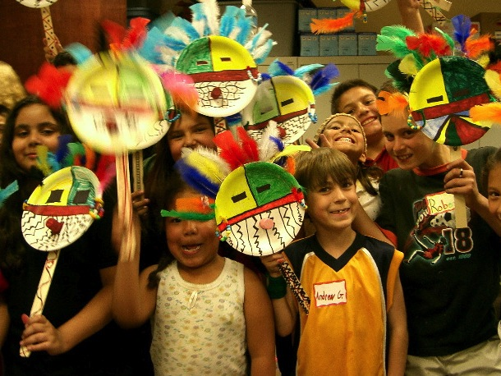
Arts Education Brings Out the Best in Students
Donna Chinn, Parent,
Los Alamitos Alliance for Arts Education
Notes:
Introduction: (15 seconds) Credentials slide
Thank school board members for their service
Introduce your credentials - I am a parent / teacher / longtime community member who has seen first hand the incredible impact arts education has in children’s lives.
Purpose (30 seconds) Purpose slide
State your purpose - I am here because like all of you I want to see the students in our schools succeed and become creative thinkers, contributors, college graduates and stellar employees and leaders. And I’ve seen first hand the powerful impact arts education can have on student’s academic success.
Share a story – Share a quick story about your son or daughter or student and how you have seen firsthand how the arts have changed their lives.

Slide 2
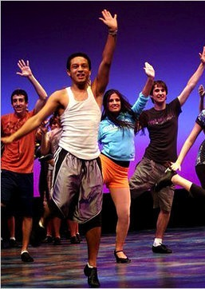

REQUEST
Restore Elementary Music Program
Hire VAPA Coordinator
Fund arts education professional development
Notes:
Ask (15 seconds) My request to the school board is to allocate funding to improve our district’s arts education offering. The best next steps to accomplish this would be:
Fill in an ask that makes sense for your district. This could include:
Restoring something that has been cut in recent years
re—hiring a VAPA coordinator for the district
Providing teachers with professional development to teach the arts
Allocate a percentage of the budget for arts education

Slide 3
LOCAL CONTROL FUNDING FORMULA
PRIORITIES
Student engagement
Parental Involvement
School Climate
Common Core Standards
Broad course of study
Student achievement
Pupil outcomes
Credentialed Teachers
Notes:
LCFF Opportunity (15 seconds) Goals slide
After years of budget cuts and a focus on testing, LCFF now gives us an incredible opportunity to fund education programs aimed at ensuring our students can succeed in school and in life.
This slide shows LCFF’s goals. Arts education can help our district achieve these aspirations.

Slide 4
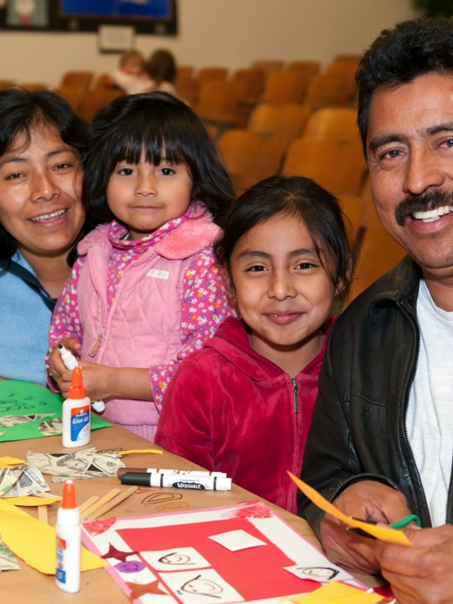
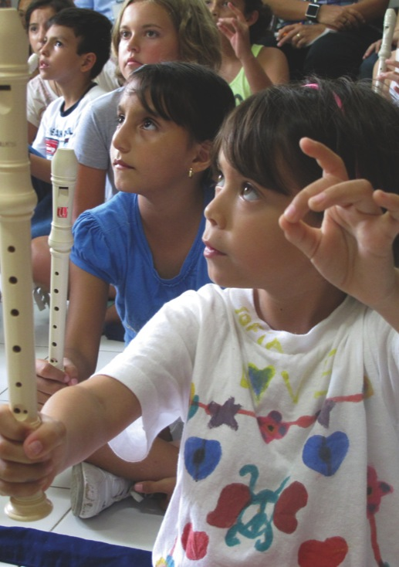
ARTS EDUCATION
IMPACT
Student engagement
Parental involvement
School climate
Common Core standards
Broad course of study
Student achievement
Pupil outcomes
Credentialed teachers
Notes:
Research shows that the arts are linked to: (15 seconds)
Increased parent and community involvement (1) as well as
Students who participate in theater and dance relate more effectively across lines of social difference (including race, ethnicity, and socio-economic background); and build a sense of community among participants
Sources:
Barry, N. H. (2010). Oklahoma A+ Schools: What the research tells us 2002-2007. Volume three, quantitative measures. Oklahoma A+ Schools/University of Central Oklahoma. - See more at: http://www.artsedsearch.org/summaries/oklahoma-a-schools-what-the-research-tells-us-2002-2007-volume-three-quantitative-measures#sthash.VTpF5LXB.RrO5pCWu.dpuf
(2) Stevenson, L. M. (2011). Creating destiny: Youth, arts and social change. (Unpublished doctoral dissertation). Stanford University, Stanford, CA. See more at: http://www.artsedsearch.org/summaries/creating-destiny-youth-arts-and-social-change#sthash.c06TwIVj.dpuf

Slide 5
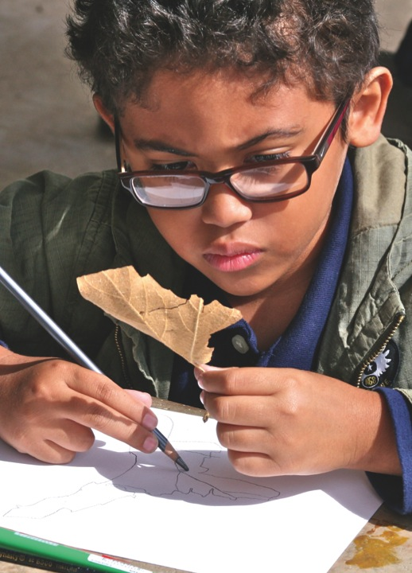
ARTS EDUCATION
IMPACT
Student engagement
Parental involvement
School climate
Common Core standards
Broad course of study
Student achievement
Pupil outcome
Credentialed teachers
Notes:
Need specific message points here
BROAD COURSE OF STUDY THAT INLCUDES ARTS EDUCATION
COMMON CORE STANDARDS
BASIC SERVICES: CREDENTIALED TEACHERS

Slide 6
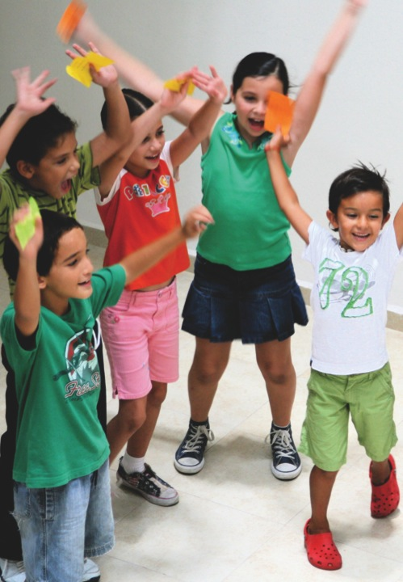
ARTS EDUCATION
IMPACT
Student engagement
Parental involvement
School climate
Common Core standards
Broad course of study
Student achievement
Pupil outcome
Credentialed teachers
Notes:
STUDENT ACHIEVEMENT (15 seconds) Low income and at-risk students with access to an arts rich curriculum are more likely to:
Achieve higher GPAs and test scores
Graduate from high school and attend college
Than those without access to the arts.
PUPIL OUTCOMES
An NEA study found that students who participated in the arts were more likely to read a newspaper, be a part of student government, participate in a social club and and volunteer to do community service.
Source:
(1 & 2) Catterall, J. S., Dumais, S. A., & Hampden-Thompson, G. (2012). The arts and achievement in at-risk youth: Findings from four longitudinal studies. Washington, DC: National Endowment for the Arts. http://arts.gov/sites/default/files/Arts-At-Risk-Youth.pdf

Slide 7
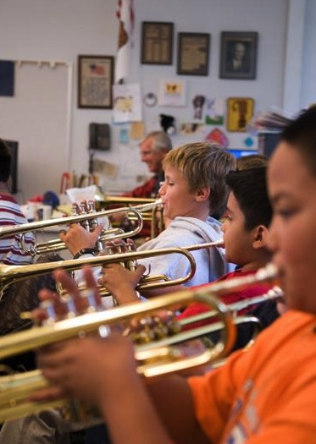
CA EDUCATION CODE
51210, 51220
“
The adopted course of study for grades 1-12 shall include visual and performing arts, including instruction in the subjects of dance, music, theatre, and visual arts.
”
Notes:
Beyond the new LCFF priorities, arts have long been a valued part of a quality education in California schools - It’s in the Education Code! (10 seconds)
Right now opportunity to deliver what our education code promises!

Slide 8
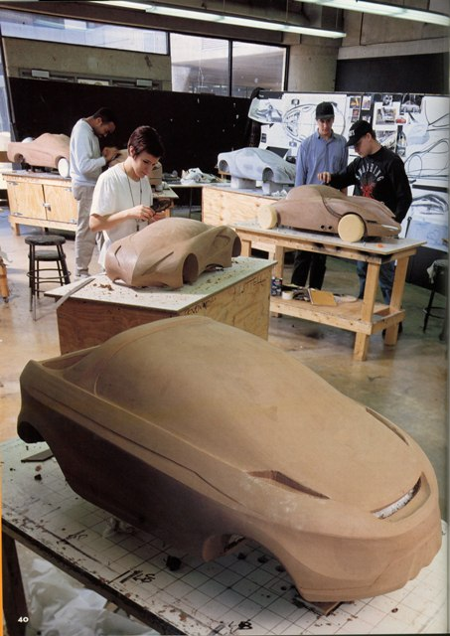
21st CENTURY
JOB MARKET
SKILLS
Creativity
Critical Thinking
Problem Solving
Communication
Collaboration
Notes:
We also know that the arts nurture skills that are essential for our students to succeed in the jobs work. (15 seconds)
In a survey of 1,500 CEOs conducted by IBM, CEOs ranked creativity as the most important leadership quality they are looking for in their workers.
(Capitalizing on Complexity: Insights from the 2010 IBM Global CEO Study. New York: IBM.)

Slide 9






SUPPORTERS
Notes:
Using arts education to promote student success is supported by education leaders locally and nationally includuing our state department of education and state PTA. (10 seconds)

Slide 10
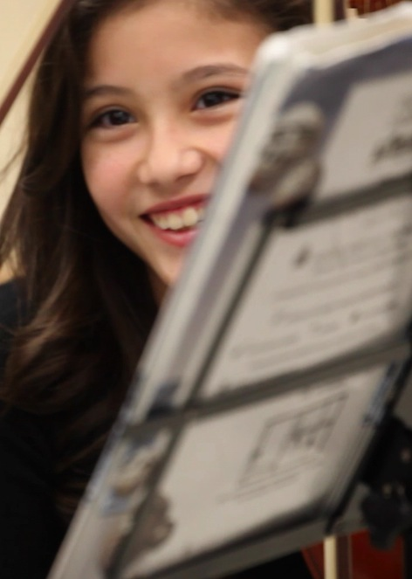
THANK YOU!
Please support
funding to
Restore Elementary Music Program
Hire VAPA Coordinator
Fund arts education professional development
Notes:
Thank you and next steps (10 seconds)

